Slide 1
GRANT MANAGEMENT SEMINAR
DISTRICT 6080
Notes:
April 1 2017 presentation
Jefferson City MO

Slide 2
PURPOSE
Understand how to manage a Rotary grant
Learn stewardship expectations
Prepare clubs to implement the MOU
Qualify clubs to receive grant funds

Slide 3
OVERVIEW OF ROTARY GRANTS
Three types of Rotary Foundation Grants:
District block grant
- up to 50% of District Designated Fund
which is generated from 3 years prior
giving to Annual Fund
Global Grants
- Package Grants

Slide 4
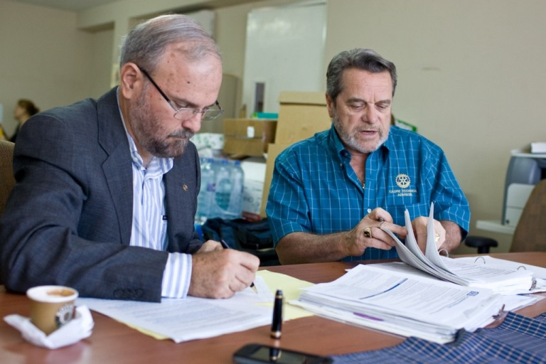
District Block Grants
Fund projects that align with the mission of The Rotary Foundation, which is to enable Rotarians to advance world understanding, goodwill, and peace through the improvement of health,,
the support of education
and the alleviation of
poverty.

Slide 5
District Block Grants
Governed by terms and conditions established by The Rotary Foundation
Fund small-scale, short term activities that address needs in our communities
District decision making with broader guidelines

Slide 6
2016-17 District Block Grant
District Simplified Grants $ 38,550
Camp Wonderland Project $ 32,250
Administrative expenses $ 824
Total $ 71,624

Slide 7
District Block Grant 2017-2018
50% of District 6080 District Designated Fund is available for District Block Grant
which is the amount of $82,629
$81,000 is made available for District
Simplified Grants to clubs per the
published allocation. (copies distributed)
$1,629 set aside for contingency

Slide 8
District Simplified Grants 2017-2018
Single project grant applications
Eligible amount per club per handout
Not required to ask for full amount eligible but must be greater than $500 and requested in $100 increments
Clubs must match grant 1:1

Slide 9
District Simplified Grants 2017-2018
APPLICATIONS ARE DUE
MAY 15, 2017
Project start: No earlier than Aug 4, 2017
Project completion: March 1, 2018
Final report deadline: April 15, 2018
Applications are available on District 6080 website

Slide 10
Foundation Grant Eligibility Guidelines
Relate to the mission of The Rotary Foundation
Include the active participation of Rotarians
Exclude any liability to TRF or RI beyond the funding amount of grant
Adhere to the governing laws of the US and the host area of the grant and harm no individuals or entities.
Sponsors for projects and travel planned for countries
sanctioned by the US Dept of Treasury office or Foreign
Assets Control may need to supply additional info.

Slide 11
Foundation Grant Eligibility Guidelines
Only fund activities that have been reviewed and approved by TRF before their implementation. Grants may not be used to reimburse clubs or districts for activities and expenses already completed or in progress. Planning for grant activities prior to approval is encouraged, but expenses may not be incurred.
After grant approval, any changes to the original project plan must be pre-approved by The Rotary Foundation.

Slide 12
Foundation Grant Eligibility Guidelines
Demonstrate sensitivity to the host area’s tradition and culture
Comply with the Conflict of Interest Policy for Program Participants per TRF Code of Policies. (document
attached to District Simplified Grant application)
Comply with the Rotary International Policies for use of Rotary International’s trademarks as outlined in TRF Code of Policies
Include signage on or in conjunction with projects in accordance with Rotary’s Voice and Visual Identity.

Slide 13
CONFLICT OF INTEREST
Exists when a Rotarian benefits financially or personally from a grant
Benefit can be direct to a Rotarian or indirect to an associate of the Rotarian
Please disclose any obvious or perceived conflicts of interest
Notes:
Speaking points:
A conflict of interest exists when a Rotarian may benefit financially or personally from grant activities.
The benefit can be either direct (the Rotarian benefits) or indirect (an associate of the Rotarian benefits).
Financial benefits could include receiving grant funds for being a project manager or receiving grant funds as a vendor for the project.
Personal benefits could include receiving a promotion, getting business referrals, or gaining publicity or improved social standing.
Associates can include family members, friends, other Rotarians, personal acquaintances, colleagues, and business partners.
Rotarians have a reputation for professional integrity. Addressing and preventing conflict of interest helps preserve this reputation for the club, district, and The Rotary Foundation.
When Rotarians freely disclose any direct or indirect association with the grant project, they help ensure fair process and transparency in the use of Foundation funds.
Rotarians must disclose any conflicts of interest on the grant application. If Rotarians aren’t sure whether a particular situation is a conflict of interest, they should talk with their grant officers.
An actual or perceived conflict of interest does not necessarily disqualify a Rotarian from participation in a Rotary grant. Eligibility for participation will be determined case by case upon disclosure of the conflict of interest.
Discussion questions:
What are some examples of conflict of interest?
Why should clubs be concerned about conflicts of interest?

Slide 14
Grant Restrictions
Grants cannot be used to unfairly discriminate against any group; promote a particular political or religious viewpoint; support purely religious functions; support activities that involve abortion or that are undertaken soley for sex determination; fund the purchase of arms or ammunition; or serve as a new contribution to the Foundation or another Rotary Foundation Grant.

Slide 15
Grants cannot fund:
Continuous or excessive support of any one beneficiary, entity or community
Establishment of a foundation, permanent trust, or long term interest bearing account.
Purchase of land or buildings
Fundraising activities

Slide 16
Grants cannot fund:
Expenses related to Rotary events such as district conferences, conventions, institutes, anniversary celebrations, or entertainment activities
Public relations initiatives, unless they are essential to project implemenation
Project signage in excess of $500

Slide 17
Grants cannot fund:
Operating,administrative, or indirect program expenses of another organization with the exception of expenses allowed within the project management allocation for global grants.
Unrestricted cash donations to a beneficiary or cooperating organization
Activities for which the expense has already been incurred

Slide 18
Grants cannot fund:
Transportation of vaccines by hand over national borders
Travel to National Immunization Days (NIDS)
Immunizations that consist soley of the polio vaccine
Study at a Rotary Peace Center partner university in the same or similar academic program as those pursued by Rotary Peace Fellows

Slide 19
Cooperating Organizations
Reputable non-Rotary organizations or academic institutions that provide expertise, infrastructure, advocacy, training, education, or other support for the grant.
Must agree to comply with all reporting and auditing activities required by TRF and provide receipts and proof of purchases.

Slide 20
Cooperating Organizations
All funding provided to cooperating organizations must be used for specific project expenses.
The sponsoring district must maintain an itemized report of such activities.

Slide 21
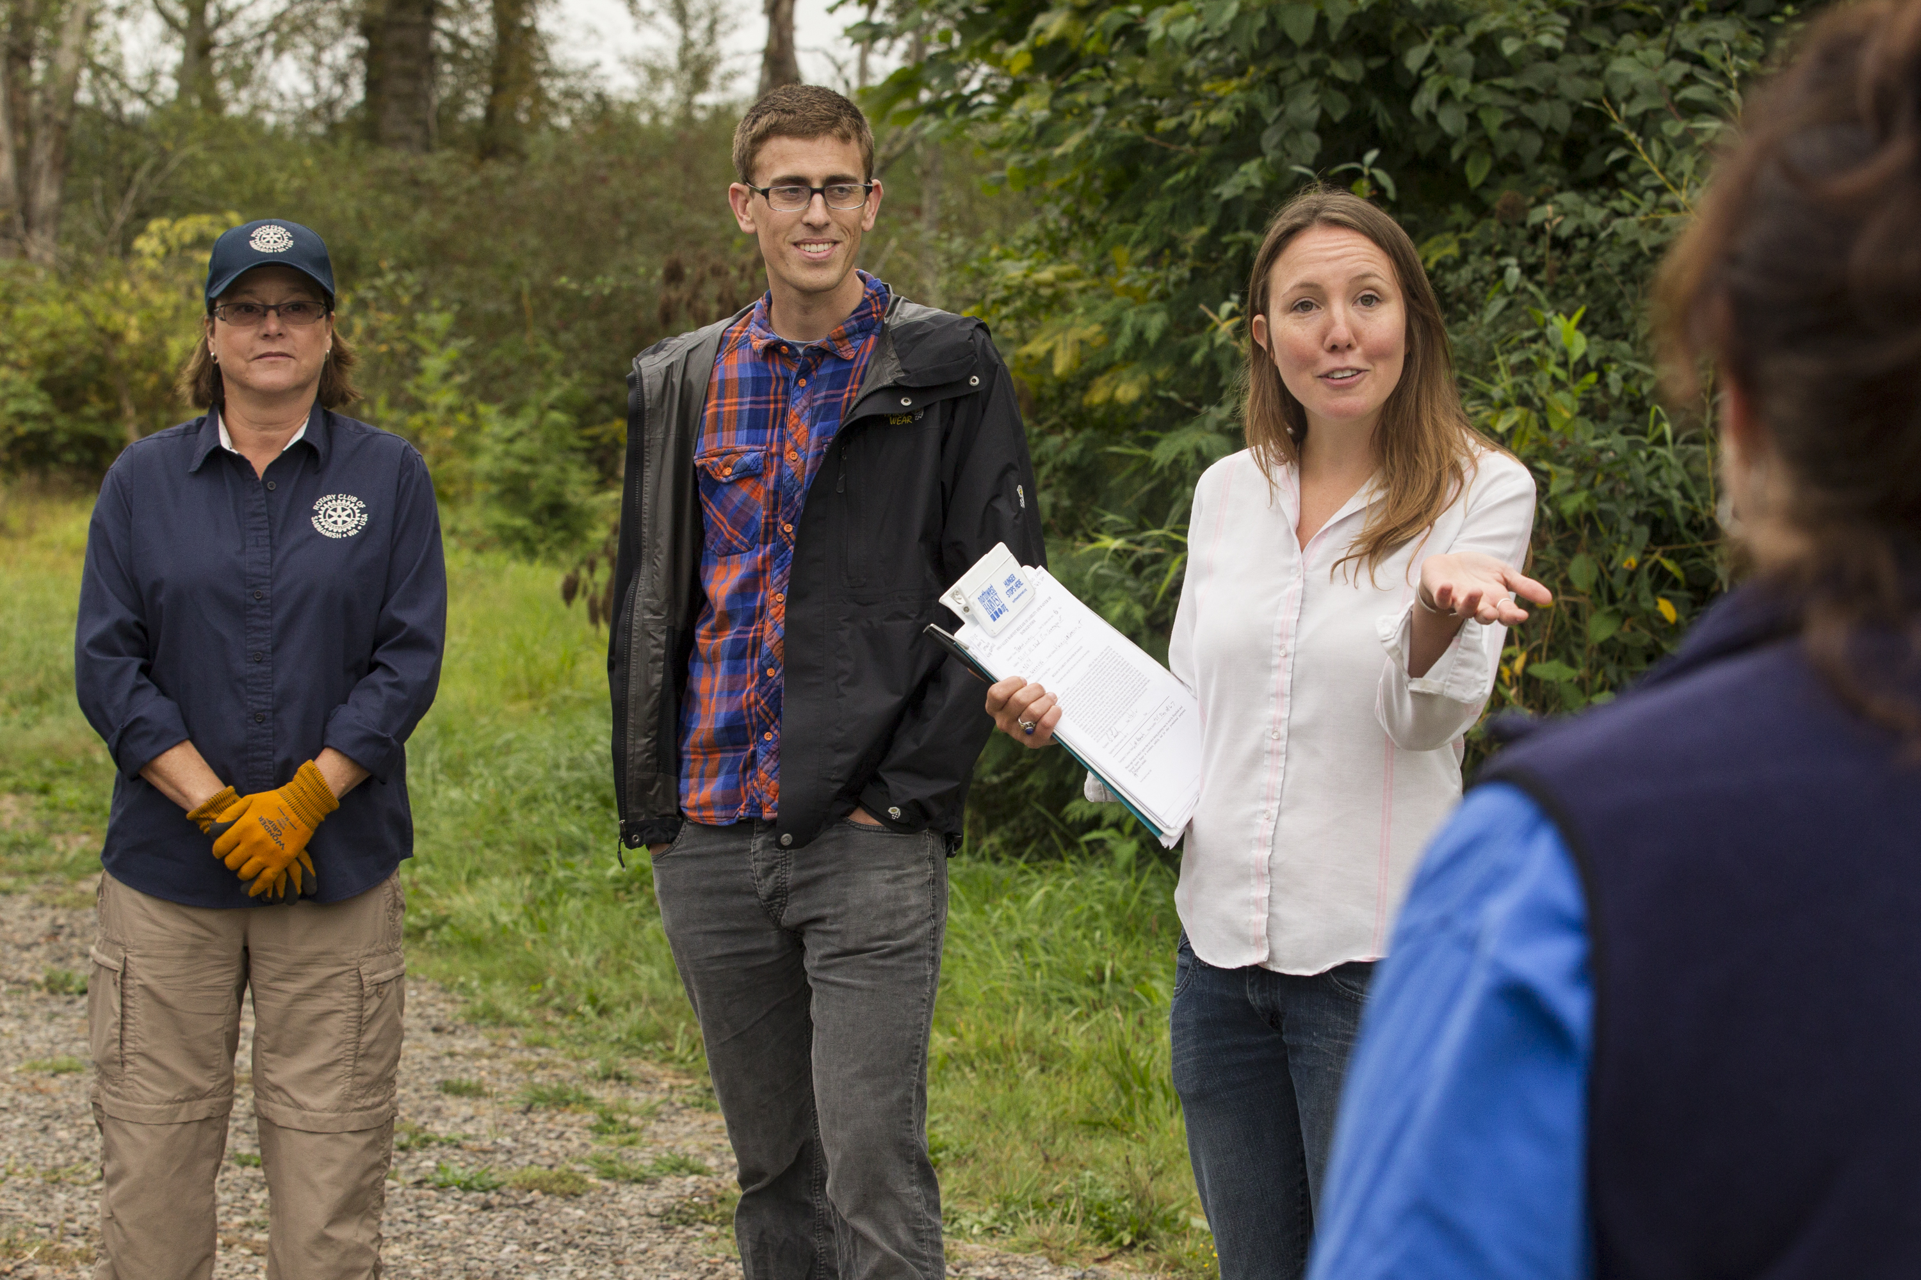
ROTARY FOUNDATION GRANTS
Global grants
Notes:
Speaking points:
Although this session will focus on applying for global grants, the grant management practices discussed can be used for all grant types.
There are three types of Rotary grants available: district, global, and packaged.
For a district grant, clubs apply to the district, following guidelines developed by the district and the Trustees of the Foundation.
For global grants, clubs apply to The Rotary Foundation, following guidelines developed by the Trustees of the Foundation.
For packaged grants, clubs apply to The Rotary Foundation, following guidelines developed by its Trustees and the strategic partner.

Slide 22
GLOBAL GRANTS
Support large international activities with sustainable, measurable outcomes in one or more of Rotary’s Six Areas of Focus.
Notes:
Speaking points:
Rotary clubs (as well as districts) can apply to Rotary for a global grant.
Global grant requests can be submitted online at any time on www.rotary.org.
To be eligible to receive a global grant, a project or activity must
Support at least one area of focus and meet at least one of that area’s goals
Be sustainable
Involve Rotary clubs in two districts in two countries (one in the project country and one in another country)
Have a minimum total budget of US$30,000
The district must confirm that a club is qualified to receive a global grant.

Slide 23

AREAS OF FOCUS
Peace and conflict prevention/resolution
Disease prevention and treatment
Water and sanitation
Maternal and child health
Basic education and literacy
Economic and community development
Notes:
Speaking point:
Each area of focus has specific goals that should be used to refine projects that are developed to meet real community needs.

Slide 24
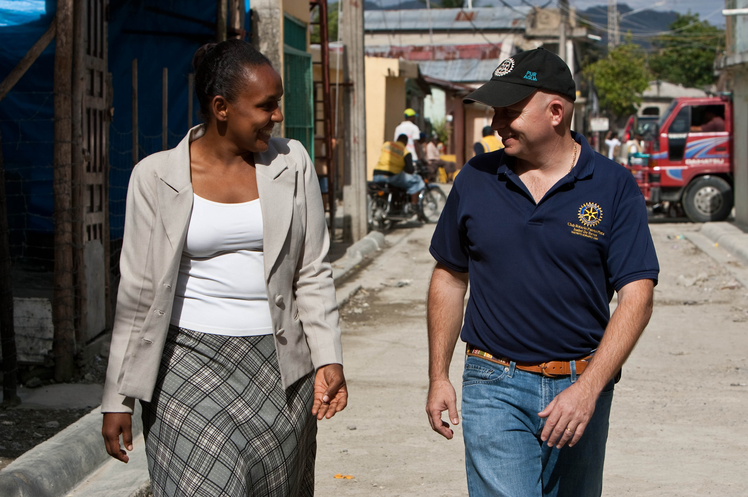
SUSTAINABLE PROJECTS
Giving a community the skills and knowledge to maintain project outcomes for the long term, after grant funds have been expended.
Notes:
Speaking points:
To be sustainable, a project or activity will continue to have an impact after the funds are expended.
A project must meet a community need that is consistent with the values and culture of the project’s beneficiaries.
Equipment and technology for a project should be purchased from local sources whenever possible. Spare parts for equipment should be available within the community. Community members should be involved in selecting the equipment and should be trained to maintain and repair it, and a local funding source should cover long-term operation, maintenance, and repair.
A project should strengthen beneficiaries’ knowledge and skills through education and training.
Project partners should collaborate with local organizations to supply expertise.
Project partners should identify individuals willing to assume leadership roles for sustaining project outcomes.
Clear and measurable project objectives should be developed and a method for collecting data established. Figures will, ideally, demonstrate change for at least three years.

Slide 25
Additional restrictions for Global Grants:
RYE, RYLA, Rotary Friendship Exchange, Rotaract, Interact
International travel for youth under 18
New construction of or additions to any structure
Travel for staff of cooperating organization involved in humanitarian project
Activities primarily implemented by an organization other than Rotary
Humanitarian projects than consist primarily of research oriented projects or data collection or individual travel expenses
Undergraduate studies
Multiple unrelated projects under one grant

Slide 26
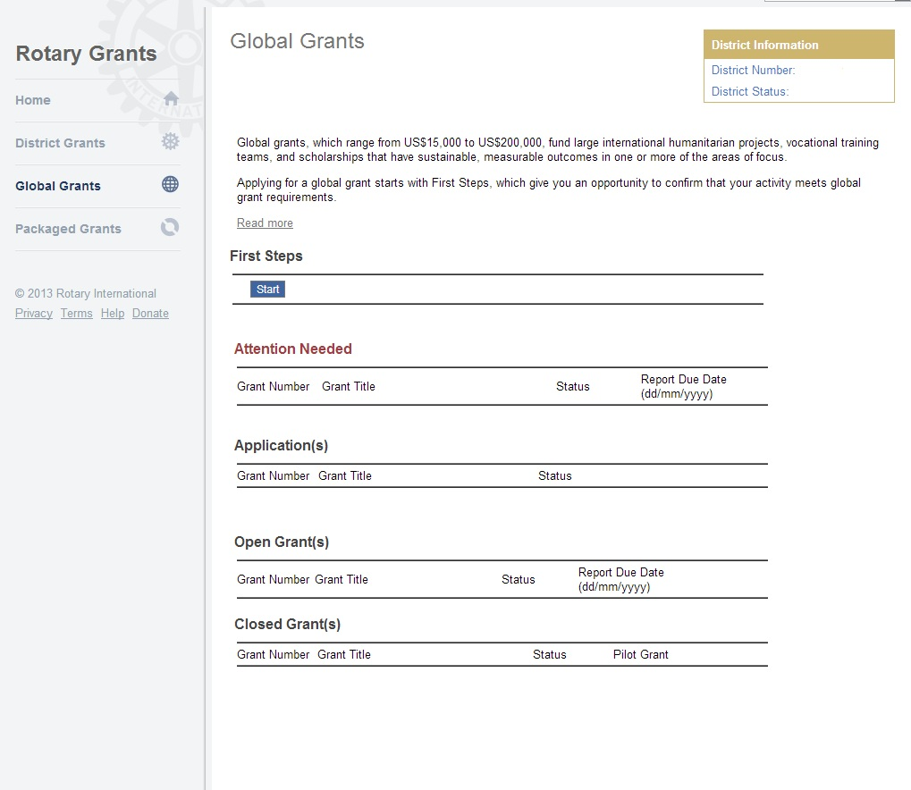
GLOBAL GRANT FIRST STEPS
Notes:
Speaking points:
Apply for a grant through Rotary’s online application system at www.rotary.org/grants.
To start a grant application, complete the First Steps by hitting the start button. It will give you general information about grant activity and best practices. After navigating through the first steps, you will be able to start your grant application.
Any open global grant applications that have not yet been approved will show up in the Application(s) section. If a grant has been approved and is still open, it will be in Open Grant(s) section. Any grants that have been completed will be in the Closed Grant(s) section.
The Attention Needed section provides alerts if any action is needed on an existing grant.

Slide 27
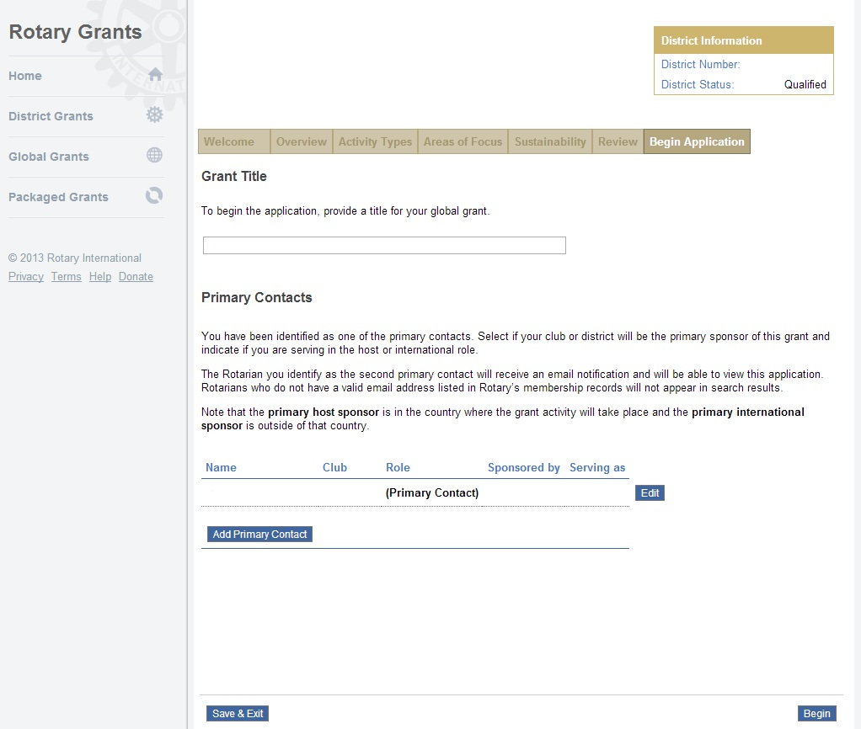
APPLICATION
Notes:
Speaking points:
Before starting your application, the primary project contacts from each of the partner clubs must already be designated. And a grant title must be decided upon. This information is required in order to proceed with the application.
Applications must include a detailed project implementation plan and budget.
If you have questions about the application, contact Rotary staff through a messaging function within the grant application system. This will help you ensure that your application is complete before submitting it.
Depending on the project’s budget and complexity, there may be multiple steps to the grant review process.
Once the grant is approved, the primary contacts from the partner clubs will receive formal notification. The club president or district Rotary Foundation chair must authorize the legal agreement to implement the grant.
Discussion question:
What steps should you take before starting the application process? What elements of your project should already be decided or completed?

Slide 28
GLOBAL GRANT FINANCING
Minimum budget for a global grant is US$30,000
Of the total budget, a minimum of $15,000 must come from the World Fund
DDF matched 100% with World Fund
Rotarian and non-Rotarian cash contributions matched
50% with World Fund
Notes:
Speaking points:
The minimum total budget for a global grant project is US$30,000.
Clubs and districts can contribute to the financing of a global grant using:
District Designated Fund (matched dollar for dollar by the Foundation’s World Fund)
Rotarian cash contributions (outright gifts from Rotarians or funds from Rotarian-led fundraisers; matched 50 cents to the dollar by the Foundation)
Non-Rotarian cash contributions (donations from other organizations, businesses, or people; matched 50 cents to the dollar by the Foundation)

Slide 29
FINANCING GUIDELINES
International sponsors provide at least 30% of total sponsor funding
Funds cannot be raised from beneficiaries or cooperating organizations in exchange for a grant
Funds cannot come from other grants
Contributions credited to donor
Notes:
Speaking points:
International sponsors of humanitarian projects are required to provide at least 30 percent of the total sponsor funding.
Rotarians cannot collect funds from beneficiaries or cooperating organizations in exchange for receiving the grant.
Contributions cannot come from other Rotary grant projects.
Cash contributions should always be credited to the individuals who gave the funds. Rotarians cannot collect funds from individuals and claim the donation as their own, unless they have received explicit permission from the donors to do so.
International sponsors of humanitarian projects are required to provide at least 30 percent of the total sponsor funding.
Discussion questions:
How do you raise cash contributions for projects?
How do you motivate donors to give more?

Slide 30
Global Grant Funding Example with 6080 DDF
Water Sanitation Project India
Good Job Rotary MO (sponsoring club) $15,000
TRF World Fund Match (50%) $ 7,500
District 6080 DDF contribution (50%) $ 7,500
TRF World Fund Match (100%) $ 7,500
Total Global Grant Funding $ 37,500
Notes:
Speaking points:
International sponsors of humanitarian projects are required to provide at least 30 percent of the total sponsor funding.
Rotarians cannot collect funds from beneficiaries or cooperating organizations in exchange for receiving the grant.
Contributions cannot come from other Rotary grant projects.
Cash contributions should always be credited to the individuals who gave the funds. Rotarians cannot collect funds from individuals and claim the donation as their own, unless they have received explicit permission from the donors to do so.
International sponsors of humanitarian projects are required to provide at least 30 percent of the total sponsor funding.
Discussion questions:
How do you raise cash contributions for projects?
How do you motivate donors to give more?

Slide 31
Global Grant Funding Example without DDF
Water Sanitation Project India
Good Job Rotary MO (sponsoring club) $20,000
TRF World Fund Match (50%) $10,000
Other Rotary clubs in District 6080 or US $10,000
TRF World Fund Match ( 50%) $ 5,000
Total Global Grant Funding $ 45,000

Slide 32

PARTNERS
Rotary Convention
Project fairs
LinkedIn
Facebook
Rotary events
www.matchinggrants.org/global
www.rotary.org
Notes:
Speaking points:
With partners, Rotary clubs are able to implement projects they could not do on their own.
Partners can include other clubs, districts, The Rotary Foundation, or non-Rotary organizations.
For global grants, projects must have a host partner and an international partner from different countries.
Both partners should be involved in all stages — from identifying the need to planning the project to implementing it and reporting on it.
For scholars, host partners play an important role in identifying a counselor and helping the scholar acclimate to the country.
For district grants, clubs can partner with clubs in the district or with other districts and their clubs.
Good communication helps keep all partners involved and allows them all to provide oversight.
Consider creating new partnerships and expanding Rotary networks.
Effective communication with project partners:
Establish how and how often you will be in contact to discuss the project.
Make sure everyone has correct information, such as email addresses for the club presidents and project committees for all partners.
Set up an alternate plan for communication, such as using a webinar, social media, or a teleconference.
Discussion questions:
What methods have you used to find project partners?
What communication strategies worked well for maintaining communication with project partners?

Slide 33
Foundation Grants
OVERSIGHT AND REPORTING

Slide 34
Oversight and Reporting of Grants
Grant management
Stewardship
Implementation of MOU
Reporting
Qualification

Slide 35
GRANT MANAGEMENT
Ensures that projects
Have proper financial control
Meet the needs of the beneficiaries
Fulfills the objectives as set forth by grant application
Safeguards funds

Slide 36
STEWARDSHIP
Stewardship is the responsible management and oversight of grant funds, including:
  Reporting any irregularities
  Rotarian supervision
  Financial records review
  Oversight of funds
  Timely submission of reports
Notes:
Speaking points:
Clubs must follow standard business practices for managing these funds.
It’s important to review financial records to confirm proper use of funds. Good stewardship is achieved by putting systems in place that create clubwide awareness of the use of funds. Widespread knowledge helps prevent mismanagement.
Any irregularities or misuse of grant funds should be reported immediately.
Submit timely, complete, and accurate reports to demonstrate good stewardship of funds to Rotary and all grant partners.
A club’s level of oversight, transparency, and accountability in managing Rotary grant funds affects donors’ confidence in giving to The Rotary Foundation and working with that club on future projects.

Slide 37
Review of Club MOU
Club Qualification
Club Officer Responsibilities
Financial Management Plan
Bank Account Requirements
Reporting
Document Retention
Reporting Misuse of Grant Funds
Notes:
Speaking points:
Your club should have a club-controlled bank account used only for grant funds. A separate account should be opened for each club-sponsored global grant. This will assist you with keeping accurate financial records. Have a plan in place to transfer custody of the club’s account in case a signatory is no longer able to perform his or her duties.
Once your club receives grant funds, it is important to have a plan for distributing and tracking funds. For example, if you are sponsoring a scholar, the plan should specify when and how your club will distribute the funds to the scholar.
Expenditures should be made using a traceable method such as a check or a bank card.
Keep track of transaction details.
Laws in some countries and regions may be more stringent than Rotary requirements. Know your local laws and follow them. When local laws are less stringent than Rotary requirements, be sure to adhere to Rotary requirements.
Discussion questions:
What are the benefits of a financial management plan?
Who is responsible for your club’s financial management plan?

Slide 38

REPORTING REQUIREMENTS
Reporting:
Verifies grants were managed properly
Provides valuable data for your club, partners, and Rotary
Notes:
Speaking points:
Reporting is a requirement, and it is a key component of proper stewardship and grant management.
If a club has already completed an evaluation of the project and maintained records in accordance with the club memorandum of understanding, completing Rotary’s reporting requirements is simple.
Reporting verifies that grants were managed properly and implemented in accordance with Rotary grant policies.
It also provides an opportunity for communication between partners, building the trust necessary to continue the partnership in support of future projects.
Reporting allows project partners and the Foundation to celebrate successes and learn from challenges.
It encourages future giving, because donors are confident that their funds have been used as intended.
It provides valuable evaluation data that the Foundation uses to improve its grant making.
It allows Rotary to demonstrate to current and future donors its effectiveness and the impact of its grants.
It allows project outcomes in each area of focus to be aggregated and marketed to Rotary’s audiences.

Slide 39
DISTRICT GRANT REPORTS
Due Date: April 15, 2018
DSG Final Report on District 6080 Website
All expenditures for your grant must be properly documented and reported
No separate bank account for DSG required but must provide the expense documentation and copy of bank statements
If working with a cooperating organization, they must submit expense documentation
Notes:
Speaking points:
Explain your district’s reporting requirements.
These requirements might include:
When reports must be submitted (relative to when the funds were received) and how often
How reports should be submitted (to whom and using what form)
What reports should include (type of information and attachments, such as financial documentation)

Slide 40
DSG Final Report Example
Grant for playground equipment at Good Job Rotary Club MO
Grant check from Dist 6080 $ 1500
1:1 match from club funds $ 1500
Include bank statement which indicates deposit of District
Grant funds into Rotary Club bank statement
Purchase of equipment from SS Playground $3,000
Include copy of invoice from SS Playground, copy of bank statement showing check to SS playground

Slide 41
DSG Final Report Ex. With Cooperating Organ.
Grant for new refrigerator at Women’s Shelter
District grant check to Rotary Club $2,000
Club 1:1 grant match from club funds $2,000
Rotary Club Check to Women’s Shelter $4,000
WOMEN’S SHELTER MUST PROVIDE DOCUMENTS FOR $4,000 PURCHASE INCLUDING CANCELLED CHECK COPY AND REFRIGERATOR INVOICE
ROTARY CLUB MUST PROVIDE COPY OF CANCELLED CHECK TO WOMEN’S SHELTER AND BANK STATEMENT INDICATING DEPOSIT OF DISTRICT GRANT FUNDS INTO CHECKING ACCT.

Slide 42

GLOBAL GRANT REPORTS
Timeline for reporting:
Progress reports within 12 months of first payment
  Every 12 months through the term of the grant
Final report within two
months of completion
Notes:
Speaking points:
Progress reports must be submitted within 12 months of receiving the first global grant payment and every 12 months afterward.
The final report must be submitted within two months of completing the project or activity.
Unused grant funds may be used for additional eligible and Foundation-approved expenses. Changes to a project must be approved by Rotary. Any unused funds returned to Rotary will be credited to the World Fund.

Slide 43

DOCUMENT RETENTION
Provide access to documents for transparency
Retain for a minimum of
five years
Make copies
Notes:
Speaking points:
All documents should be accessible to everyone in the club. For example:
Keep documents in a binder or a file system, or
Scan documents and save them electronically to a shared network
Documents must be retained for a minimum of five years -- or longer if local law requires it.
Discussion questions:
What is your club’s system for document retention?
What types of documents need to be retained?

Slide 44
District 6080 QUALIFICATION REQUIREMENTS
Attend the District Grant Management Seminar
Agree to by submitting the signed Memorandum of Understanding (MOU) to District Grants Subcommittee Chair, Susan Hart
Clubs applying for and receiving District Simplified Grants will be excused from certain requirements as outlined on the MOU
Notes:
Speaking points:
Clubs must qualify to receive Rotary Foundation global and packaged grant funds. The process ensures that clubs are aware of all Rotary requirements before receiving grant funds and provides clubs with the tools needed to complete these requirements and successfully manage their projects.
By attending this training, participants complete the first step toward qualification. One club member must attend this seminar annually and then share the information with fellow club members.
The second step is to have the club president and president-elect sign and submit the club MOU.
Discussion questions:
Has your district told you what the requirements are? Do you understand all of them?
How will you communicate this information to your club members?

Slide 45
TERMS OF QUALIFICATION
Valid for one year
Club responsible for grant funds
Disclose conflicts of interest
Cooperate with all audits
Use grant funds properly
Implement the club MOU
Timely reporting of grant funds
Notes:
Speaking points:
Once a club successfully completes the qualification requirements, the club will receive qualified status for one Rotary year.
All club members understand that the club as an entity is responsible for the use of grant funds.
The club must disclose any conflicts of interest in compliance with the Conflict of Interest Policy as outlined in The Rotary Foundation Code of Policies.
The club must cooperate with any site visits, reviews, and audits.
Misuse of grant funds could result in suspension of the club’s qualification status.
Failure to implement the club MOU could result in a loss of qualified status.
Discussion questions:
How will you ensure that your club or district will comply with the MOU requirements?
If it appears funds have been misused, how will your club handle the situation?

Slide 46
Thank you!

