Slide 1
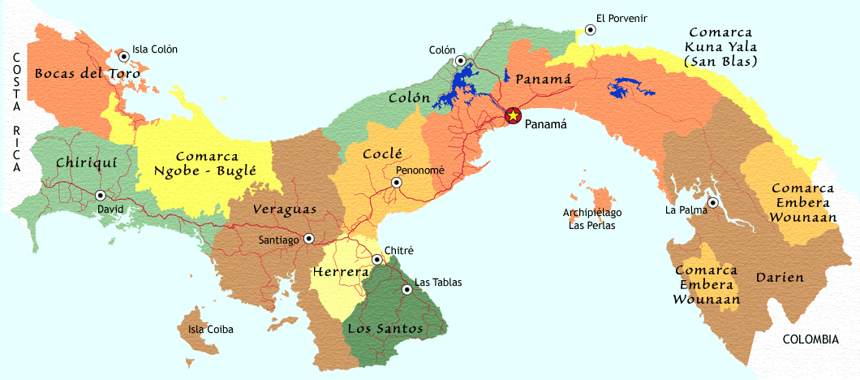
Republic of Panama Provinces
Caribbean Sea
Pacific Ocean

Slide 2
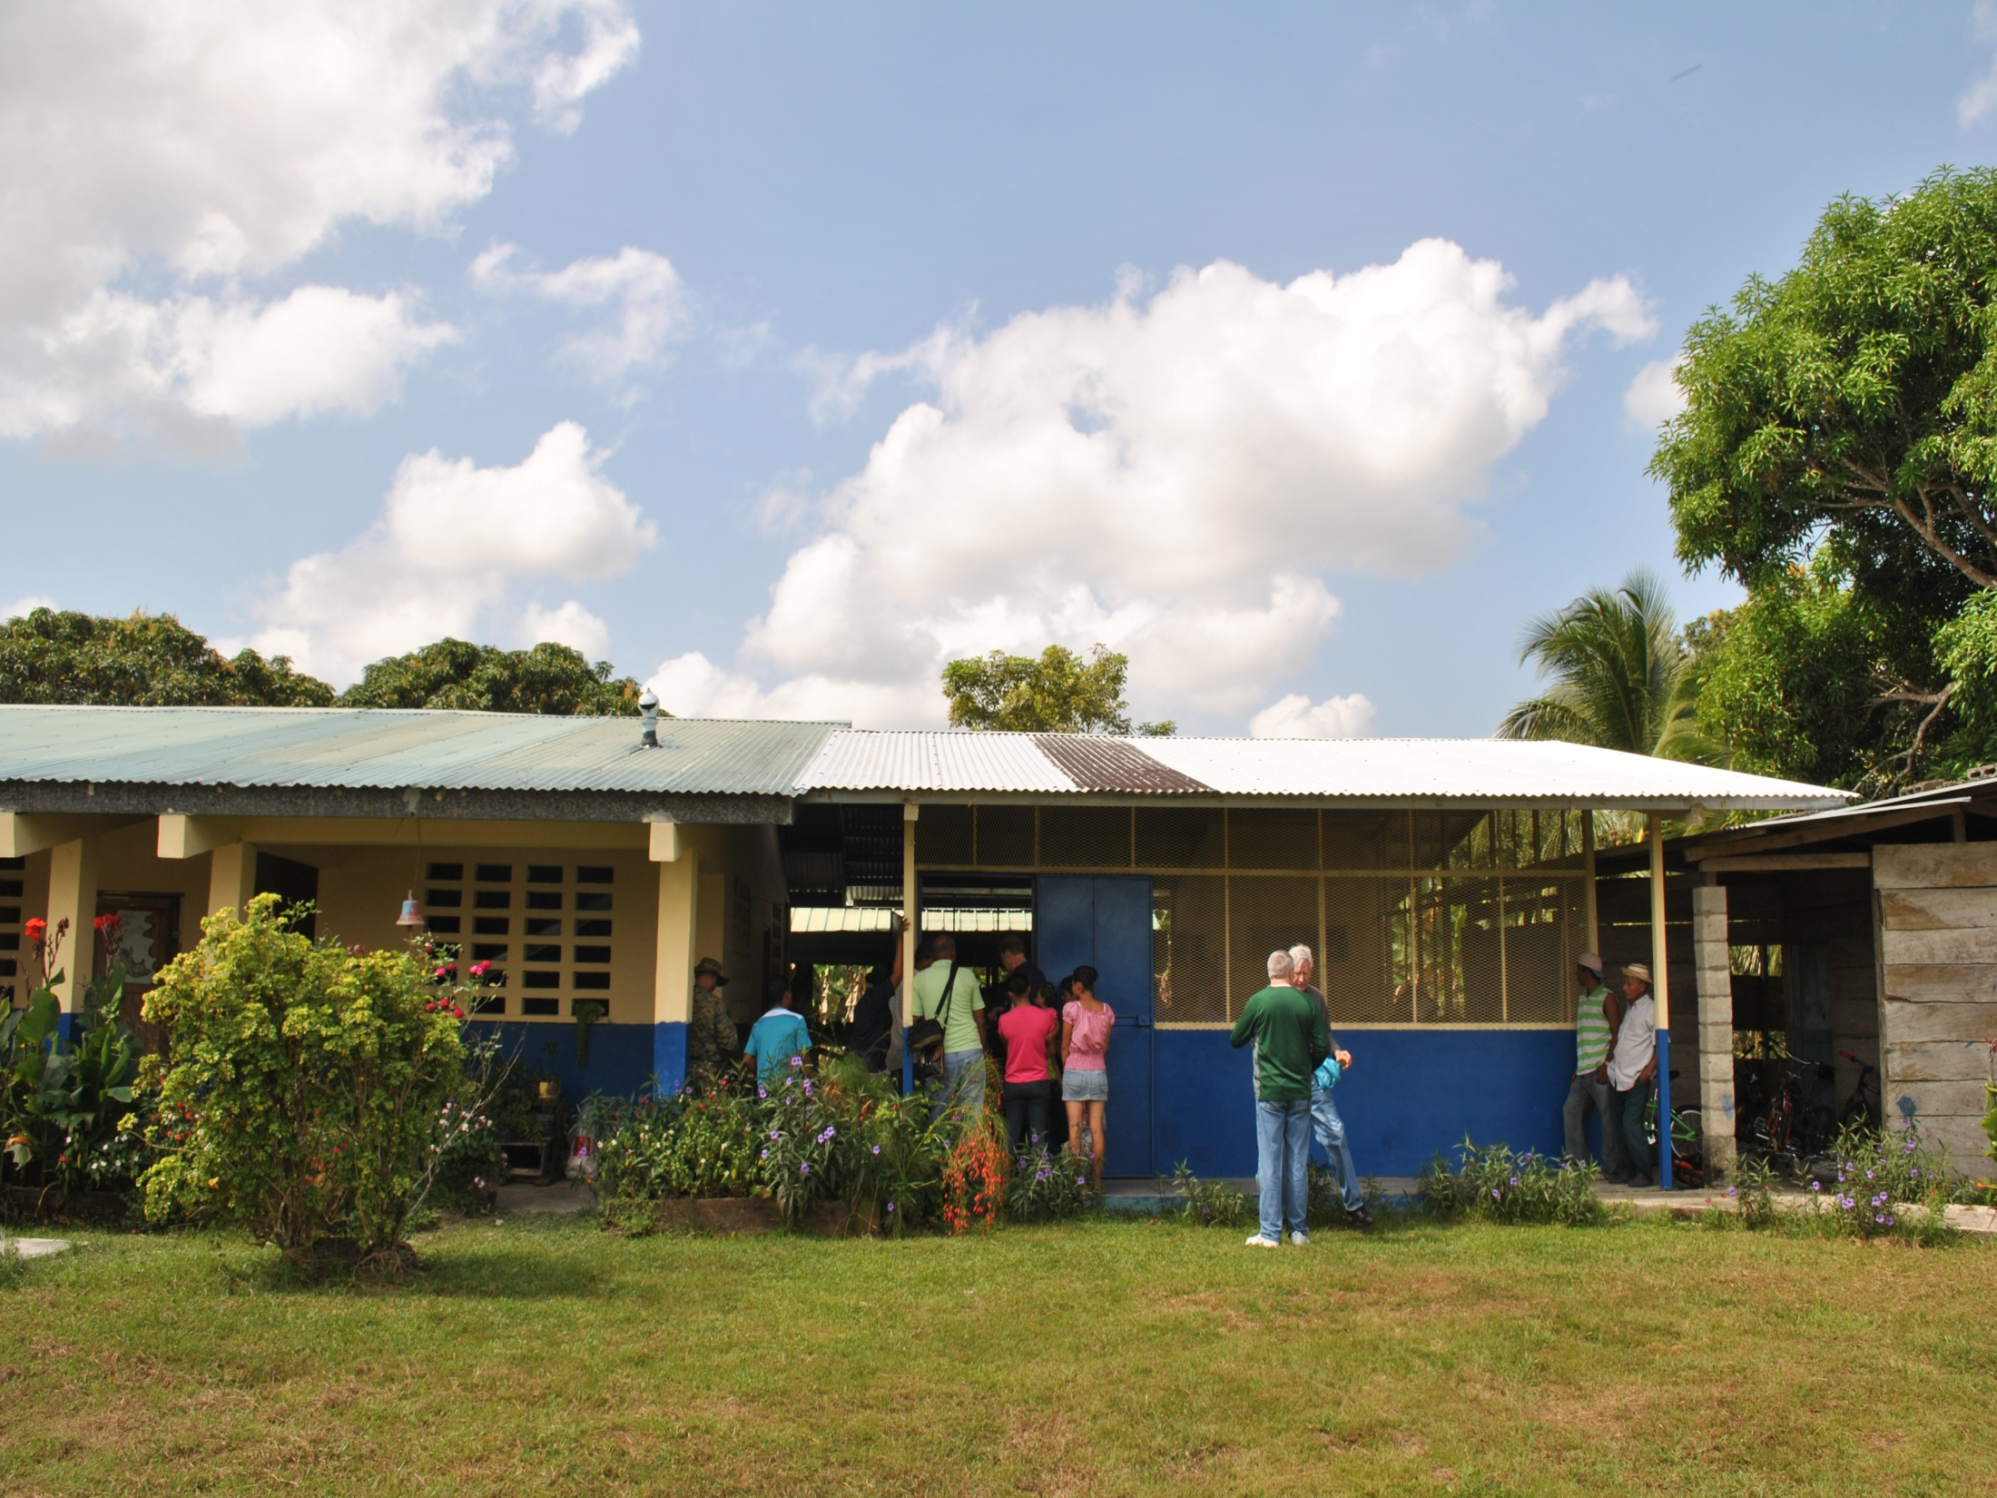

Slide 3
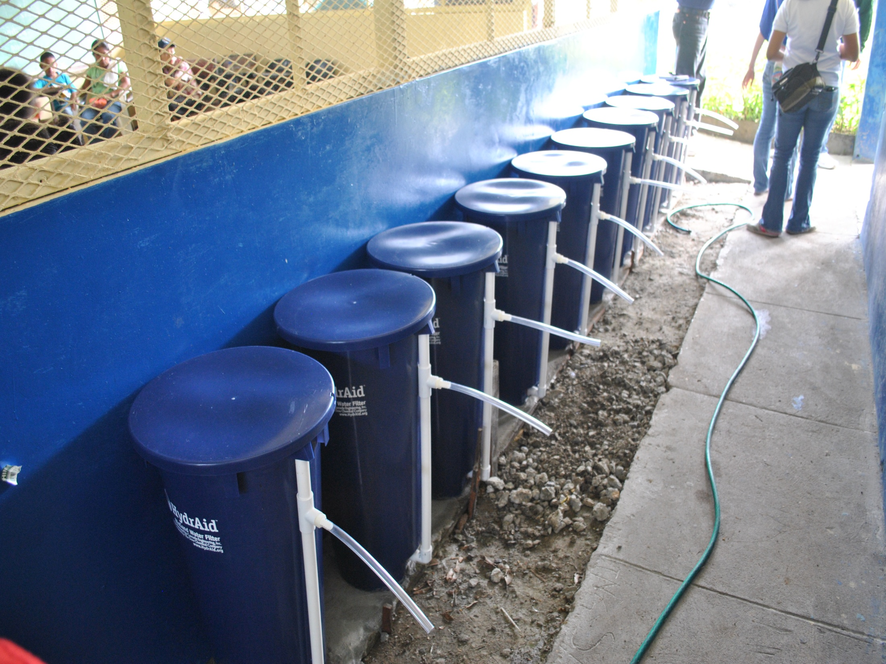

Slide 4
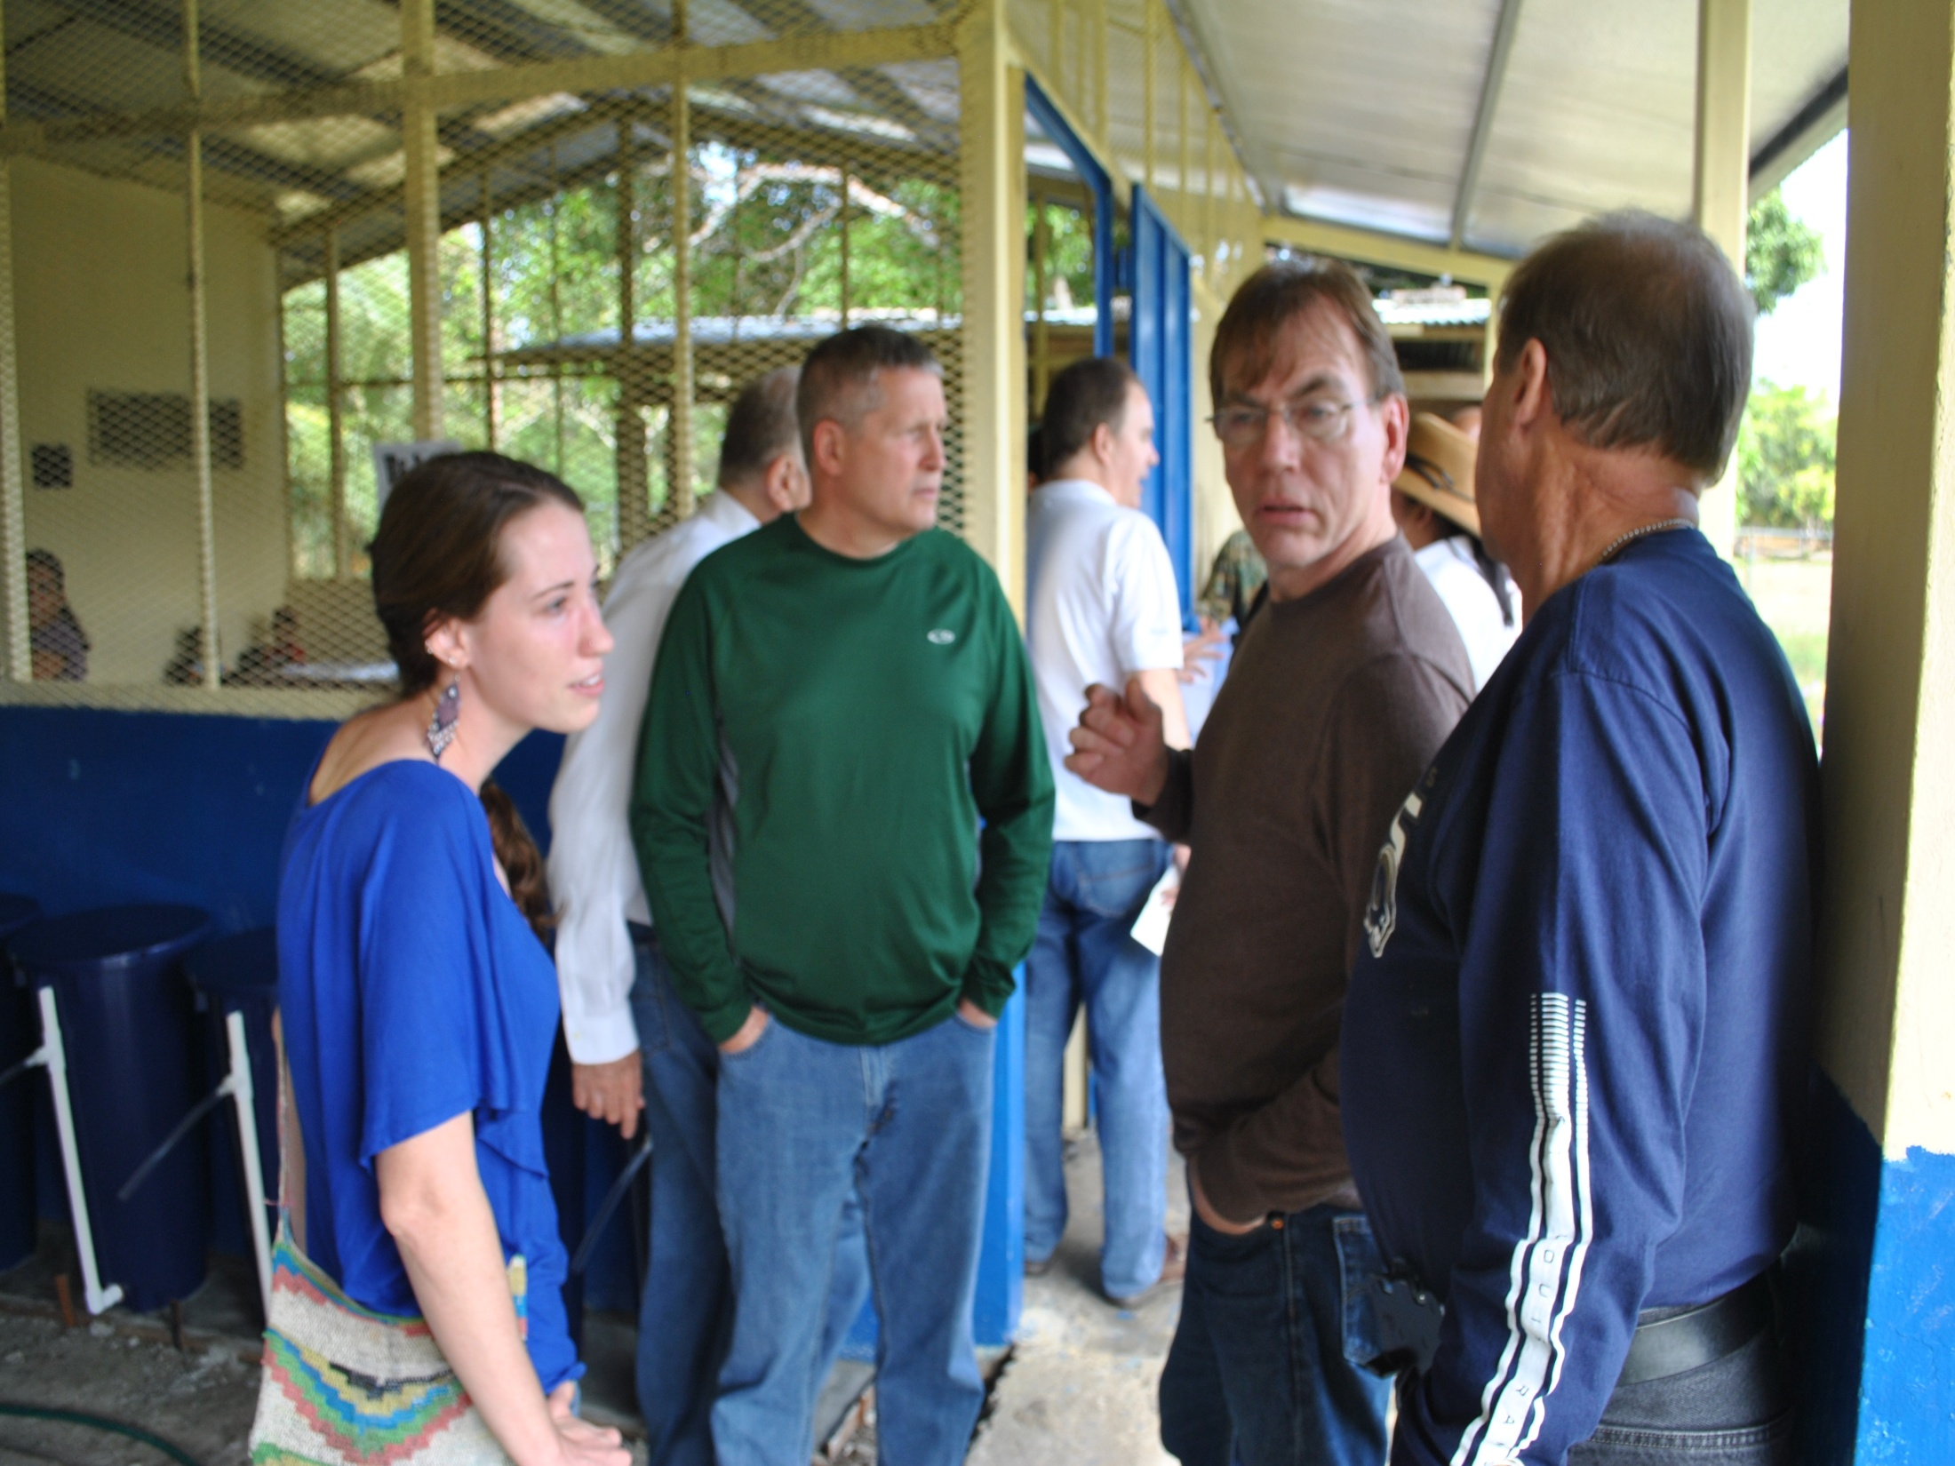

Slide 5
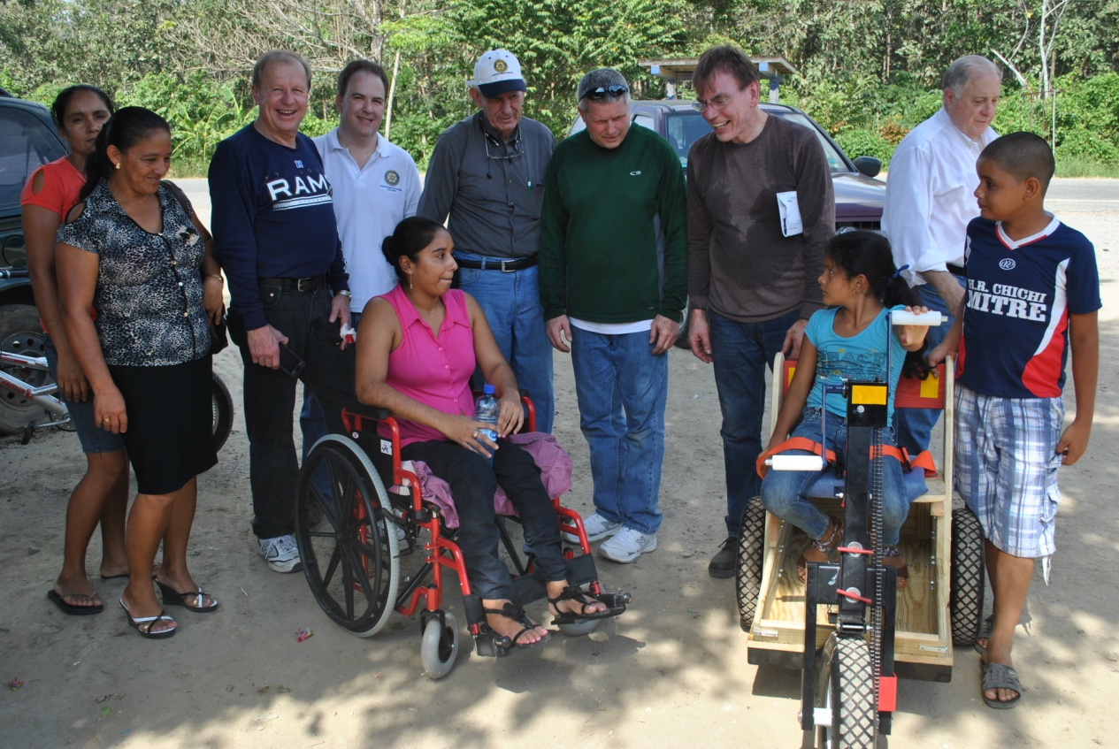
PET Distribution in Darién Province
(Personal Energy Transportation)

Slide 6
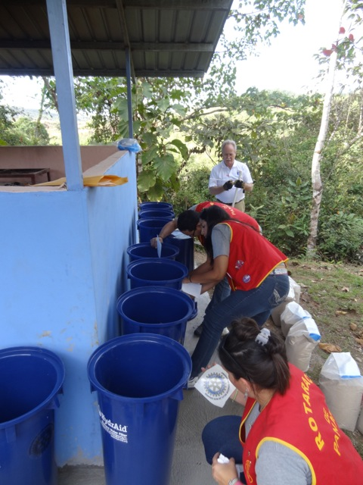
Rotoract Club members
installing HydrAid BSF’s
in the village of
Chumicosa, Panama

Slide 7
